Slide 1
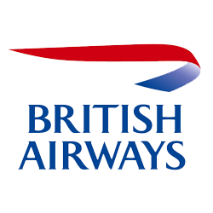
Webscraping to gain company insights
Scrape and analyse customer review data to uncover findings for British Airways
Created by Tram Nguyen
On 27.08.2023

Slide 2
Task 1
British Airways (BA) is the flag carrier airline of the United Kingdom (UK). Every day, thousands of BA flights arrive to and depart from the UK, carrying customers across the world. Whether it’s for holidays, work or any other reason, the end-to-end process of scheduling, planning, boarding, fuelling, transporting, landing, and continuously running flights on time, efficiently and with top-class customer service is a huge task with many highly important responsibilities.
As a data scientist at BA, it will be your job to apply your analytical skills to influence real life multi-million-pound decisions from day one, making a tangible impact on the business as your recommendations, tools and models drive key business decisions, reduce costs and increase revenue.
Customers who book a flight with BA will experience many interaction points with the BA brand. Understanding a customer's feelings, needs, and feedback is crucial for any business, including BA.
This first task is focused on scraping and collecting customer feedback and reviewing data from a third-party source and analysing this data to present any insights you may uncover.

Slide 3
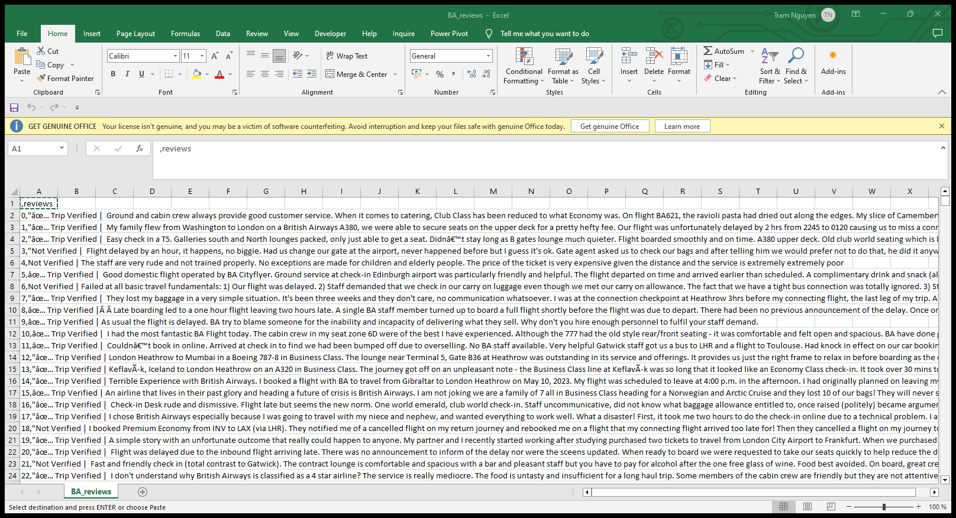
Webscraping
Tool: using Python Jupyter Notebook and BeautifulSoup to collect all data links and text content in each customer reviews.
Csv file: BA_reviews.csv (1000 rows and 2 columns)

Slide 4
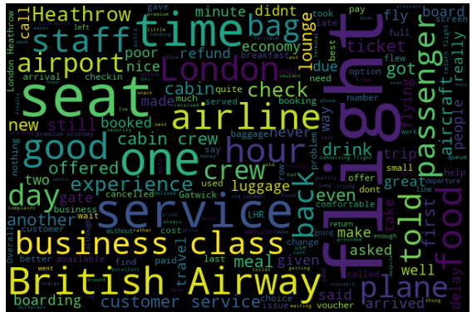
Text Analysis
WORDCLOUD
Using NLTK library (natural language kit) to split each word out of the whole sentence.
Count the frequency (how many times) each word occurs.
The size of the wordcloud is determined by the frequency distribution of words.
It can be concluded that important topics discussed by customers in review are about service, flight, staff, time, seat, …etc.

Slide 5
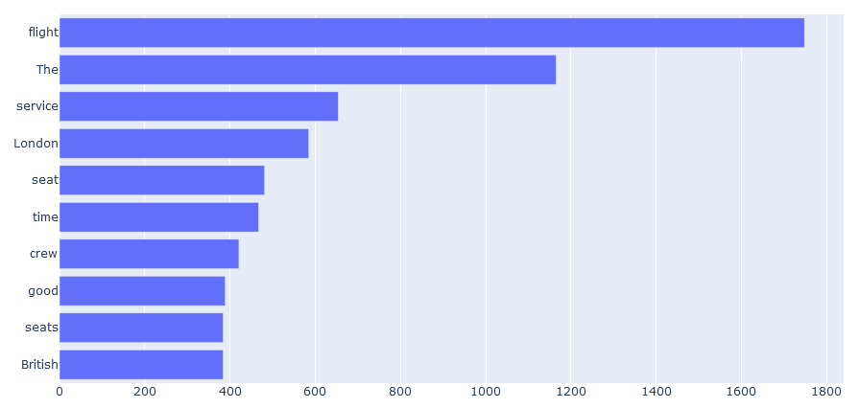
Text Analysis
Top 10 most common words by frequency distribution

Slide 6
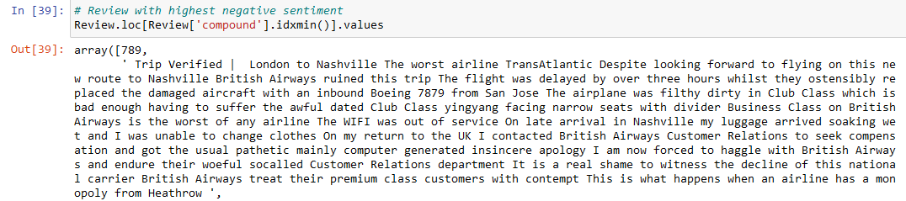
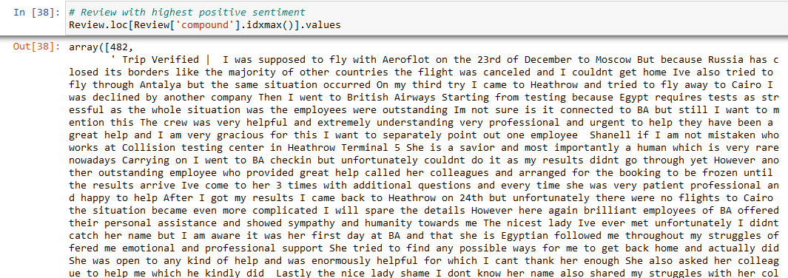
Text Analysis
Sentiment Analysis
Using NLTK tool SentimentIntensityAnalyzer to calculate polarity score, which evaluates each review and assigns score to it based on three dimensions: negative, neutral and positive. Moreover, the compound element is equivalent to the overall score of the review.
The overall score range is -0.9925 and 0.9989
The average overall score is 0.1643, which is equivalent to 5.8087 on the 10 scale.

Slide 7
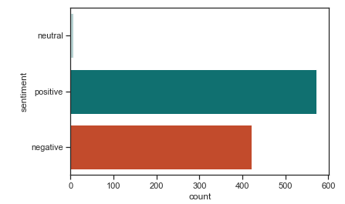
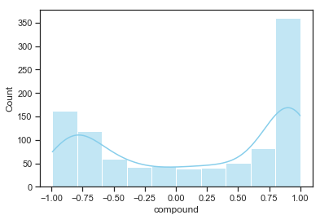
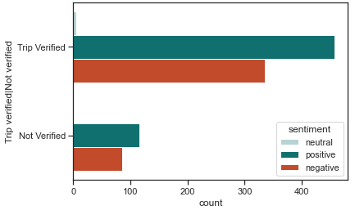
Text Analysis
There are 573 positive reviews, 421 negative reviews and 6 neutral review.
The number of positive reviews always outweighs the number of negative reviews regardless if the trip is verified or not. As to the verified trip the ratio of positive:negative is higher than that of not verified .
Most reviews are located at the two ends of the histogram shape, indicating that customers are either very satisfied or very unsatisfied to the service. Fewer customers give neutral opinions.

Slide 8
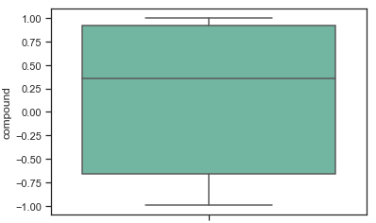
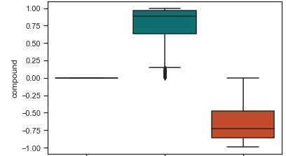
Text Analysis
The overall score’s distribution is slightly left skewed with approximately half all the review falls over 0.35 meanwhile mean score is 0.1643.
Above all, there are still rooms of improvement for
British Airways when it comes to service enhancement.
Most reviews are located at the two ends of the histogram shape, indicating that customers are either very satisfied or very unsatisfied to the service. Fewer customers give neutral opinions.

